Slide 1
Jalview Workshop
Adva Yeheskel
Bioinformatics Unit, Tel Aviv University
8/5/2018

Slide 2
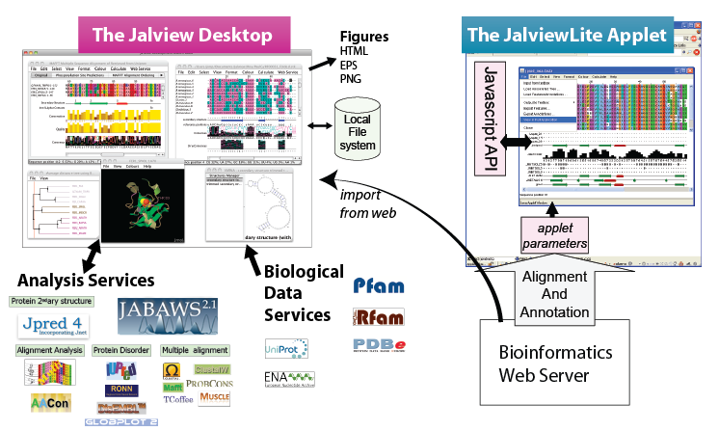
Installing Jalview
Install on your computer:
http://www.jalview.org/Web_Installers/install.htm
OR
2. Use the applet
http://www.jalview.org/

Slide 3
Agenda
1.Interface
2.Upload sequences
3.Create alignment
4.Edit alignment
5.Analysis (colors, groups, secondary structures, annotations etc.)
6.Attaching structures and phylogenetic trees
7.Save sessions, alignments, figures

Slide 4
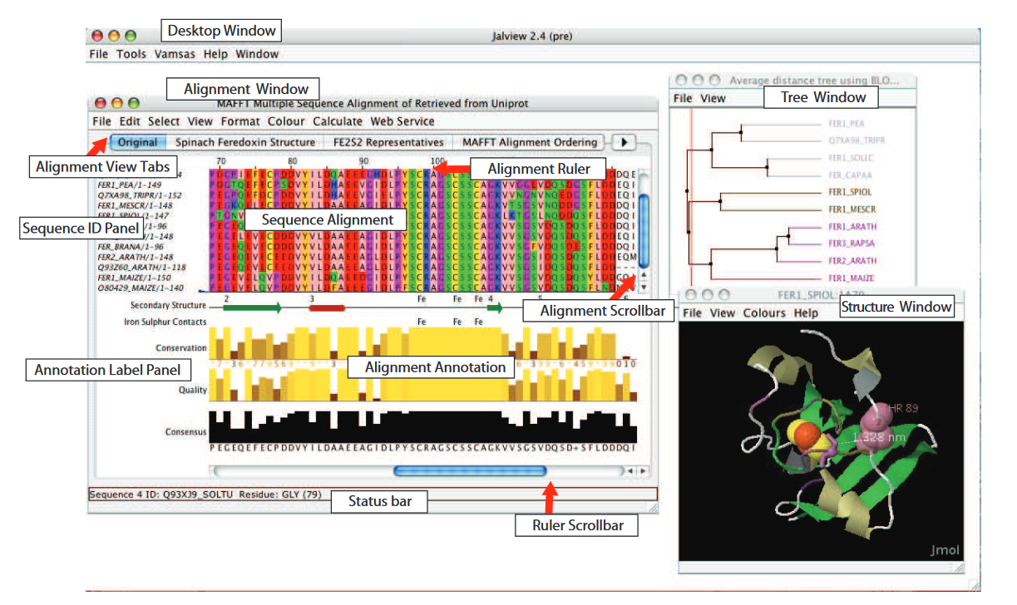
Interface

Slide 5
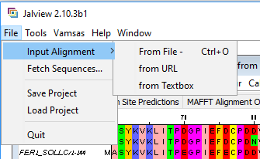
How to start ?
Upload your sequences:
From file
From textbox (copy & paste)
Fetch sequences (from Uniprot, PFAM etc.)

Slide 6
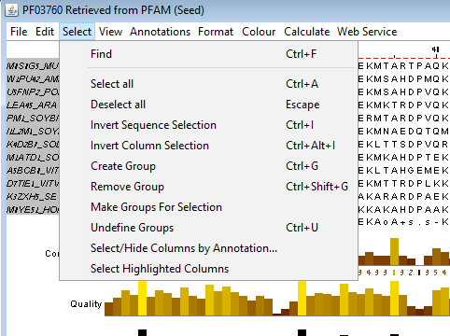
Selections
Title
Column
Part of the sequence
Find

Slide 7
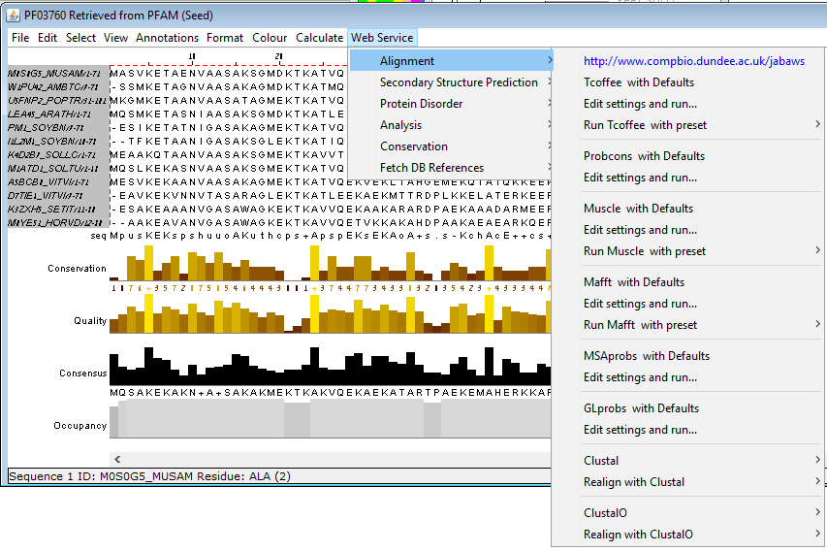
Calculate alignment
Select what to align
Choose alignment method
The alignment will be opened in a new window

Slide 8
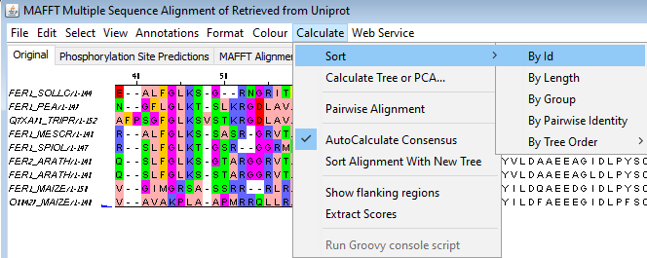
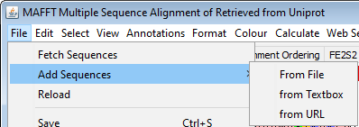
Edit the alignment
Remove a sequence: select a sequence and click Ctrl + Delete
Hide sequence or column using the right mouse click
Sort using the Calculate tab
Add / remove gap:
select a sequence
Move the mouse over the wanted column
Click the Ctrl key and the left mouse button
Move the mouse to drag sequence to open or close gaps
Left and right arrow keys are also an option
Add a sequence using the File tab
* You might want to remove empty columns after editing (Ctrl+ E)

Slide 9
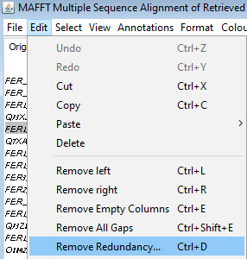
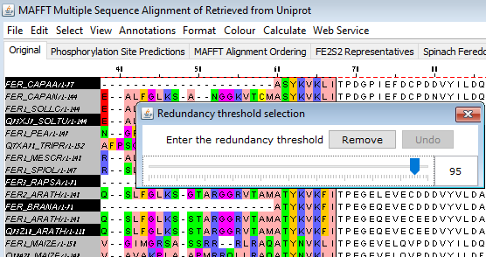
Alignment editing: remove redundancy

Slide 10
Pairwise alignments
Option 1: recalculate best pairwise
Select two sequences
Calculate pairwise alignment.
You can view the result in a new alignment editor window
Option 2: based on the MSA
Select two sequences
Edit -> copy
Edit -> paste to a new alignment

Slide 11
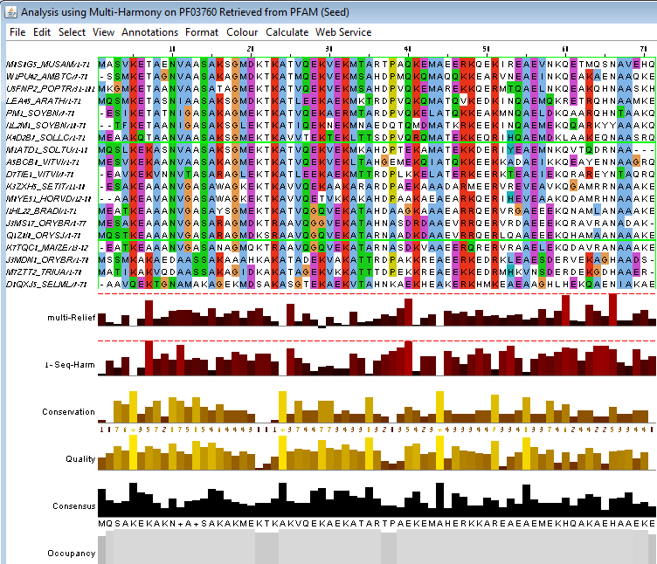
Analysis: groups and what are they for
Select several sequences
Group them together
Run multi-harmony analysis
4. You can add or delete gaps in all sequences of a group using Ctrl+mouse drag

Slide 12
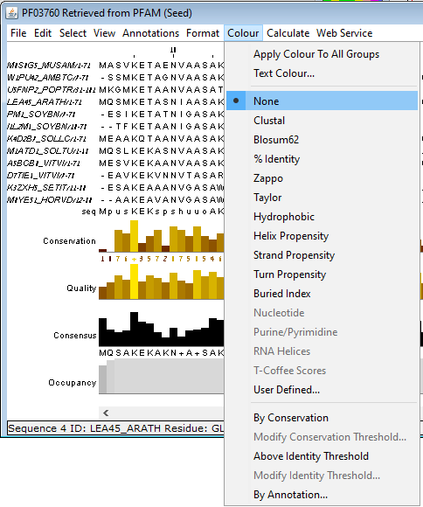
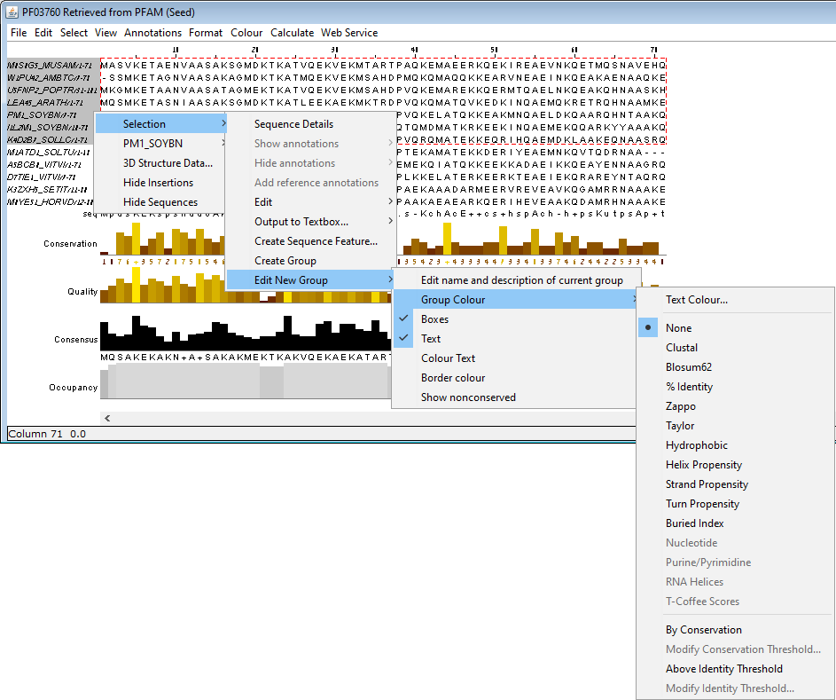
Analysis: coloring schemes
or a selection (group of sequences)
Color the entire alignment

Slide 13
Analysis: shade by conservation
The intensity of the coloring scheme can be scaled by the degree of amino acid property conservation.
Select Colour -> by conservation and slide the bar in the conservation colour increment window

Slide 14
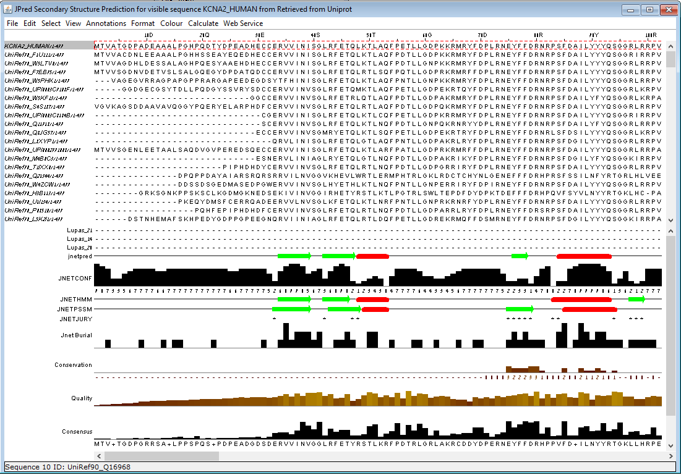
Analysis: secondary structure
Secondary structure prediction (using jpred)
Manually add a prediction
Upload a prediction

Slide 15
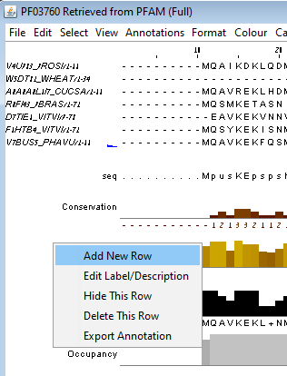
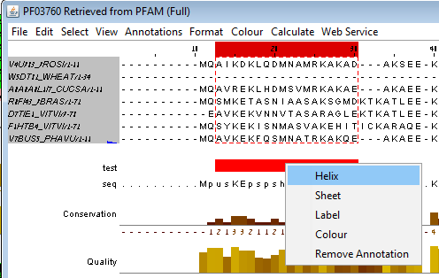
Analysis: annotations
Add a new row of annotation under the alignment by right click on the annotations panel, give it a name and then select regions and mark them

Slide 16
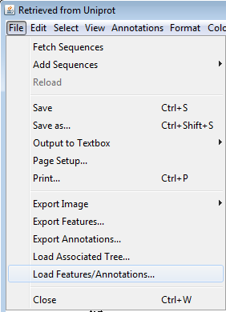
Analysis: annotations
Upload annotation file
Annotations can be manually edited in the text file

Slide 17
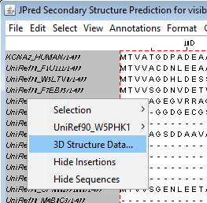
3D structure
Select sequence(s) and right click. Choose “3D Structure Data…”
Jalview will present a list of available structures from the PDB. alternatively you can upload a file and associate it with a selected sequence.

Slide 18
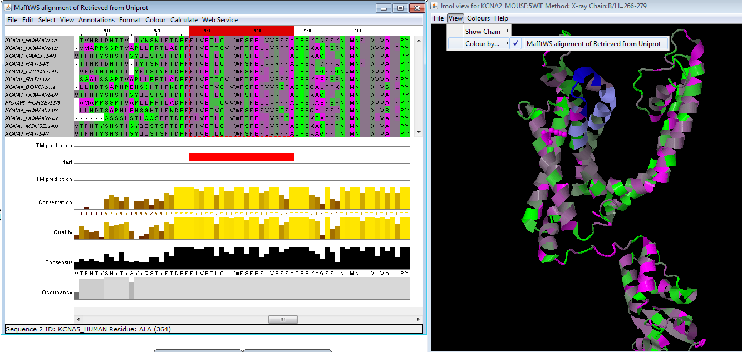
3D structure
The colors of the structure and sequences are associated.
Mouseover an atom highlights the associated position and vice versa.

Slide 19
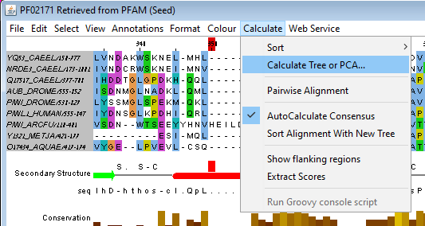
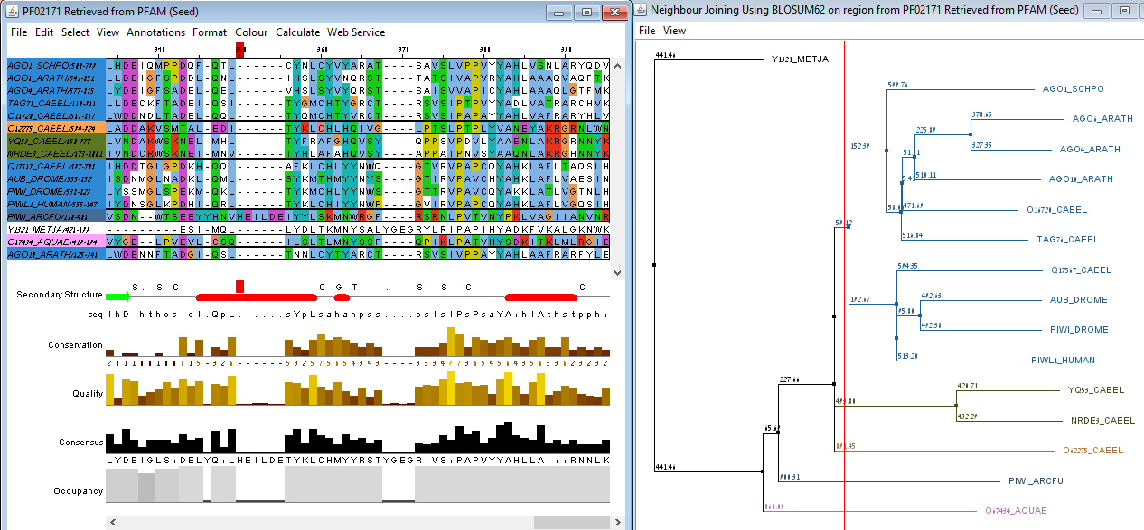
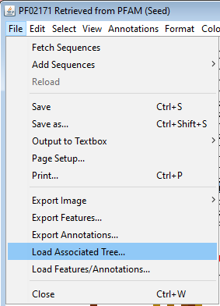
Phylogenetic trees
Calculate tree (from Calculate tab) or upload a tree file (from File tab)
Click on the tree and the sequences titles will get highlighted in the same coloring scheme as the tree leaves.

Slide 20
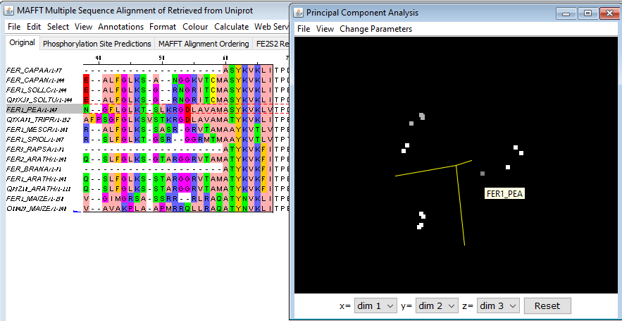
Principal Component Analysis (PCA)
This analysis is a spatial representation of the similarities between the selected sequences.
Calculate PCA using the calculate tab. Click on a dot and the appropriate sequence title will be highlighted.

Slide 21
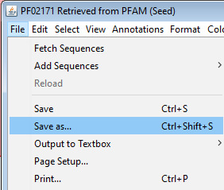
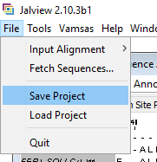
How to save sessions and alignments
Save alignment: only the sequences (titles and gaps) of a specific alignment window
Save project: saves all visible alignments annotations, coloring and predictions

Slide 22
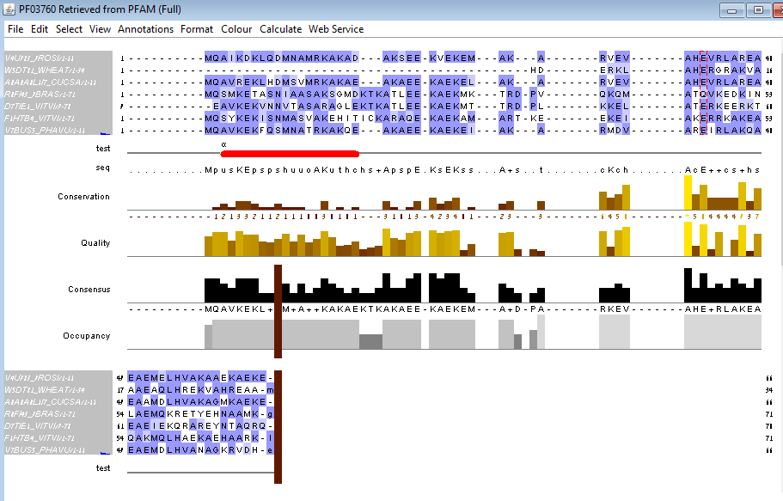
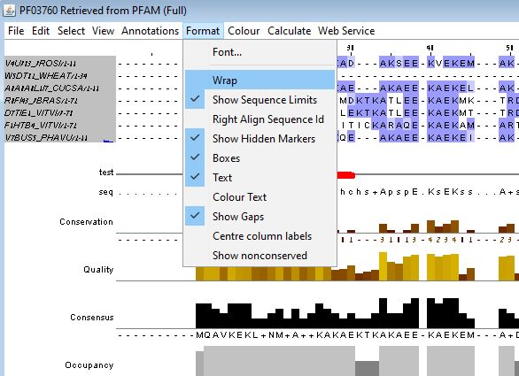
Create alignment images: WRAP
Avoid wide figures of long sequences by wrapping the sequences to the selected window size

Slide 23
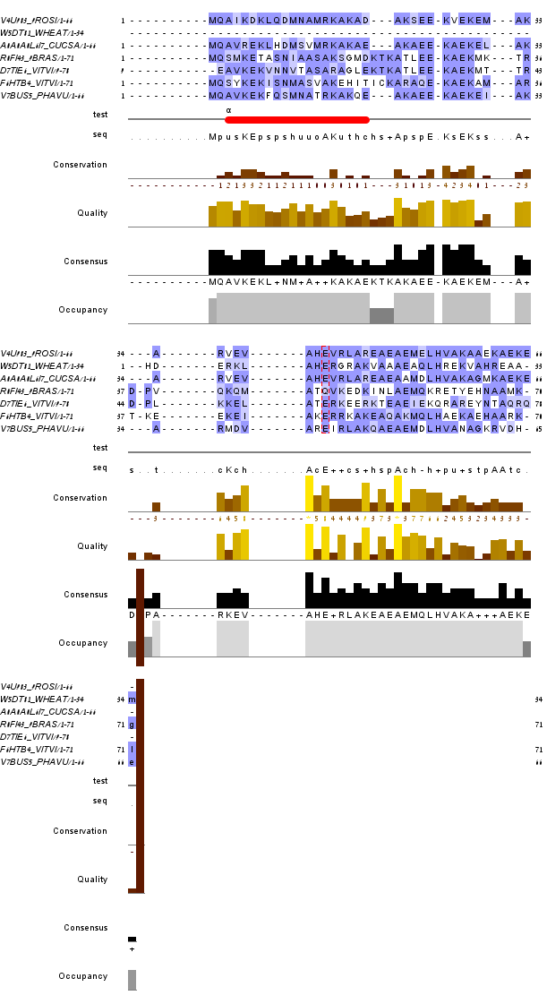
Export alignment image
Select the wanted window size, then export a figure is the selected format (File tab)
* Unwrap if you need to change something in the alignment

Slide 24
Getting help
Tutorial: http://www.jalview.org/tutorial/TheJalviewTutorial.pdf
Documentation (F1)

